Slide 1
CAPSTONE PROJECT “SHOP FOR HOME”
JAVA And AWS C1
MENTOR-
MR-NEERAJ KUMAR KHERIA
GROUP-6

Slide 2


Teammates-
SANAPALA SAIKRISHNA
HARSH DUBEY
CHANDRA LAKSHMI MANASA
LAKSHMI SAILAJA BHARATHI GANESH
KAVYA MUDILI

Slide 3
CONTENTS-
INTRODUCTION
AIM
TECHNOLOGIES USED
GOAL OF THE USER
GAOL OF ADMIN
CONCLUSION

Slide 4
Introduction
Nowadays most of the purchasing of items that are needed for the daily basis can be done through online mode.
There are many websites where people can buy their stuff through online like Ikea, Amazon and etc
Shop for home is a popular store in the market for shopping the Shop for home.
In this project we created a ecommerce website to provide all the services to the users through online.
There are 2 users in this application:
1. User
2.Admin

Slide 5
Aim
This project aims to develop an online shopping for customers with the goal so that it is very easy to shop their loved things virtually without going to any store from their home
The objective of the project is to make an application in android platform to purchase items in an existing shop.
In order to build such an application complete web support need to be provided. A complete and efficient web application which can provide the online shopping experience is the basic objective of the project. The web application can be implemented in the form of an android application with web view.

Slide 6
Technologies Used:
Angular - Frontend
Database – MySQL And XAMPP
Java(Eclipse) and Spring boot - Backend
AWS Services
IDE- Visual Studio Code , Eclipse.
Versioning: GitHub

Slide 7
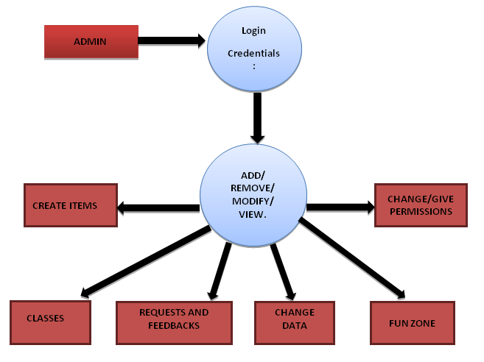
The admin does the following activities:
Manages the product
Manages the order
Manages the user
Manages the items

Slide 8
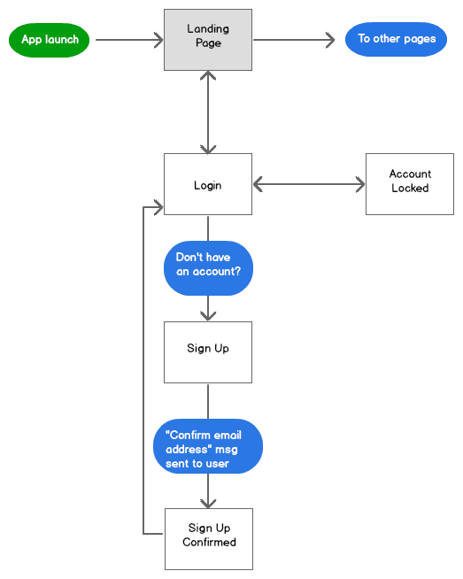
The login page of the user contains the following attributes:

Slide 9
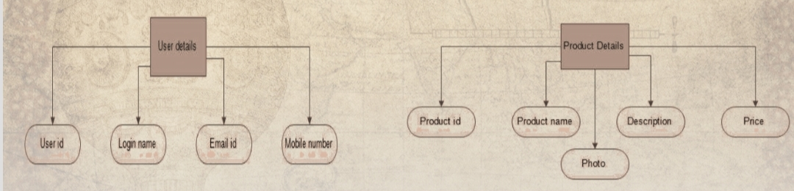
User details of a particular user:
Product details of a particular product:

Slide 10
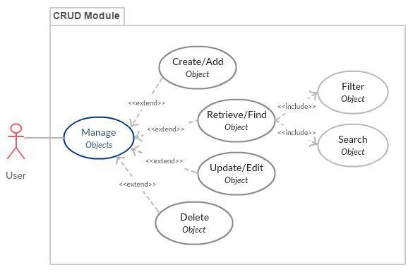
The manage product module do the CRUD operations:
The CRUD options can be applied on the product and can be updated in the database.

Slide 11
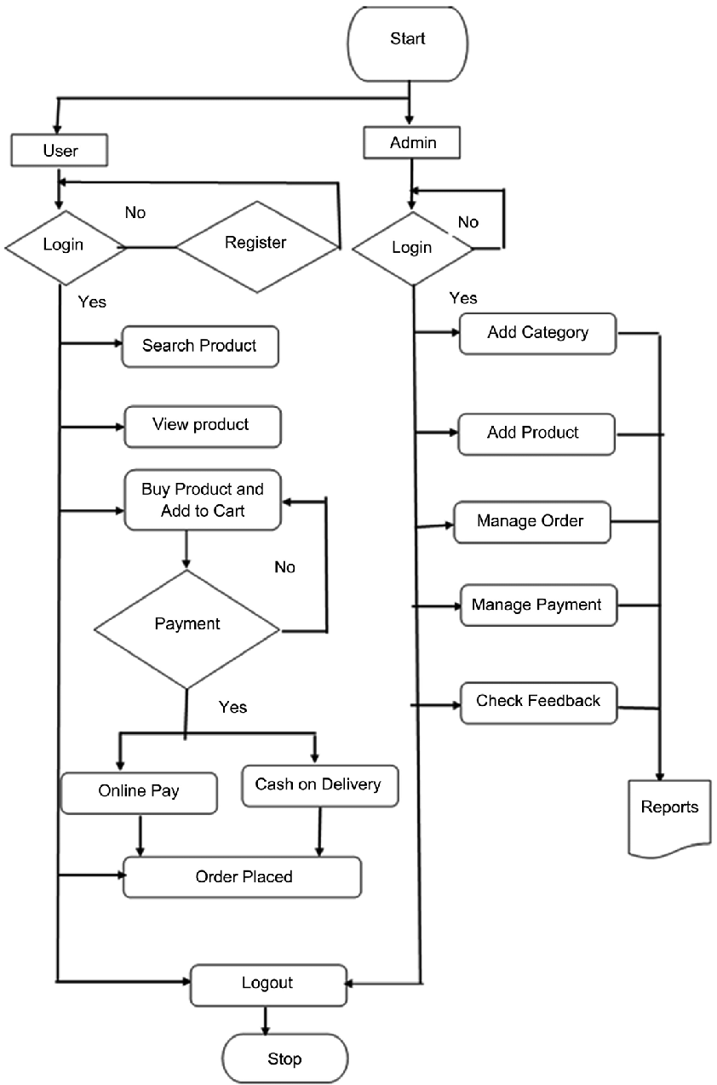
The overall view of a project:

Slide 12
Goal of User
User can be able to Login, Logout and Register into the Application.
User can be able to see the Products in different categories.
The user can also be able to sort the products.
User can be able to add the products into the shopping cart.
User can be able to increase or decrease the quantity added in the cart.
User can be able to add “n” number of products in the cart.
User can be able to get the Wishlist option where the user can add those products which he want but don’t want to order now.
User gets the different discount coupons.

Slide 13
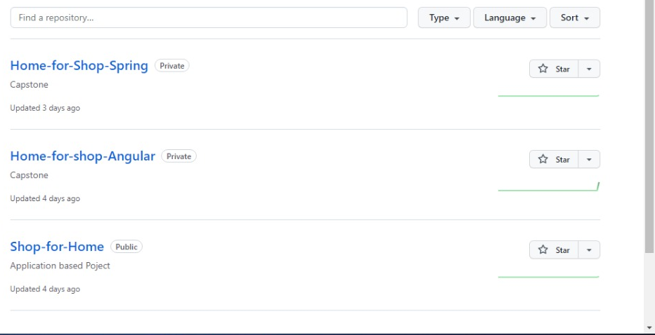
Git Repository-

Slide 14
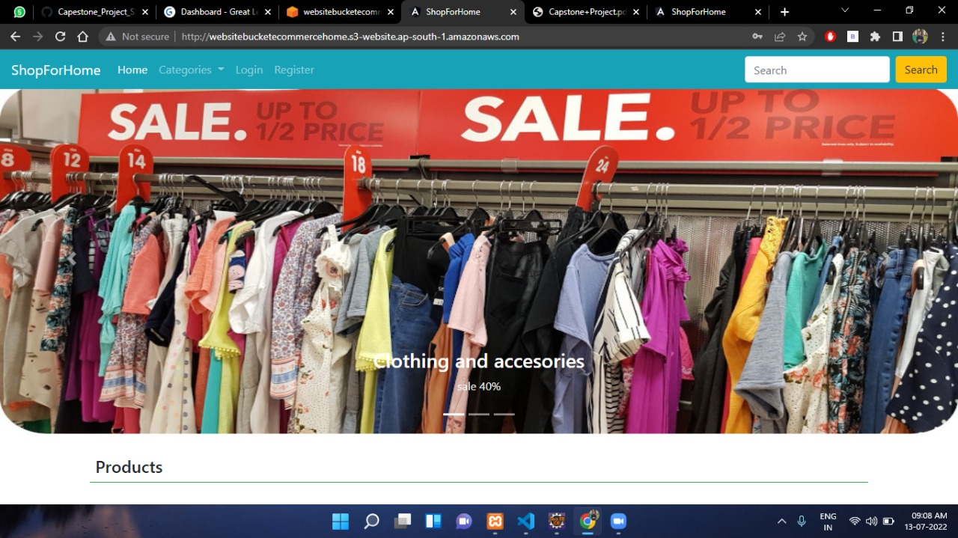
HOME PAGE(USER)-

Slide 15
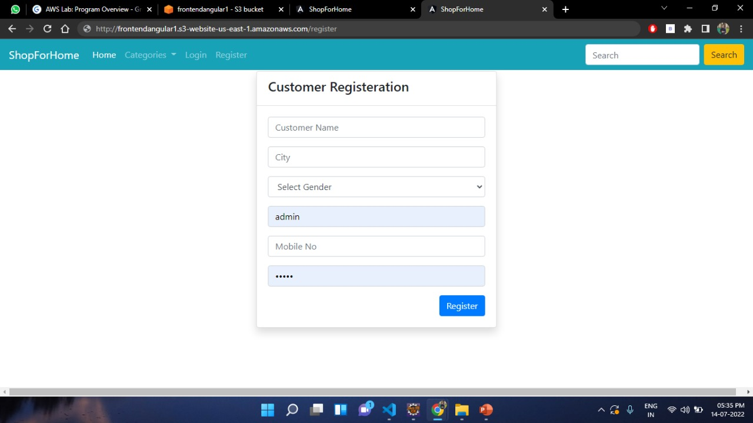
CUSTOMER REGISTRATION-

Slide 16
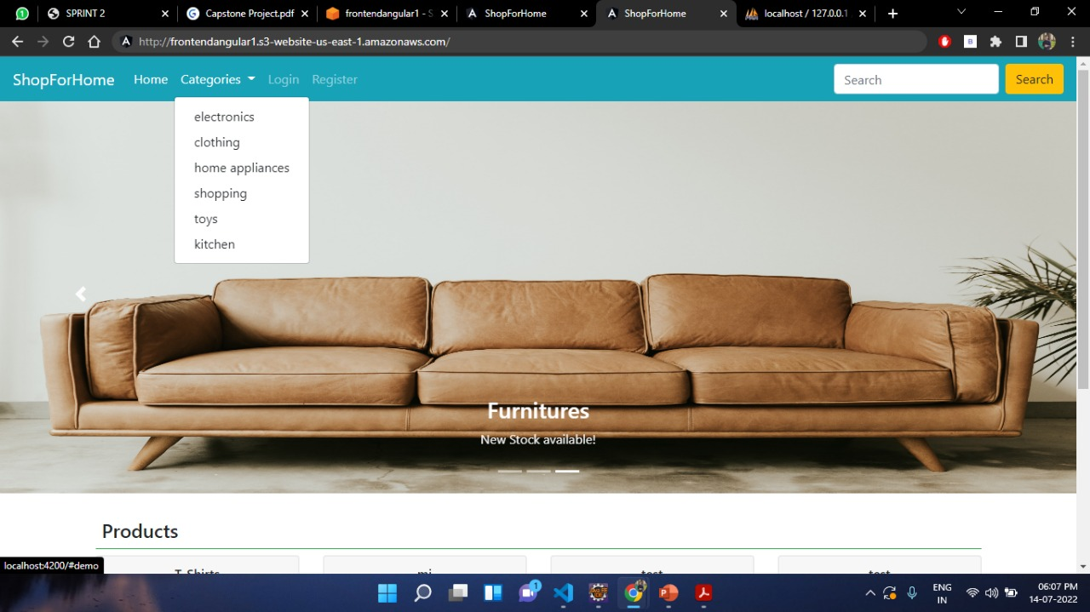
CATEGORIES(User side)-

Slide 17
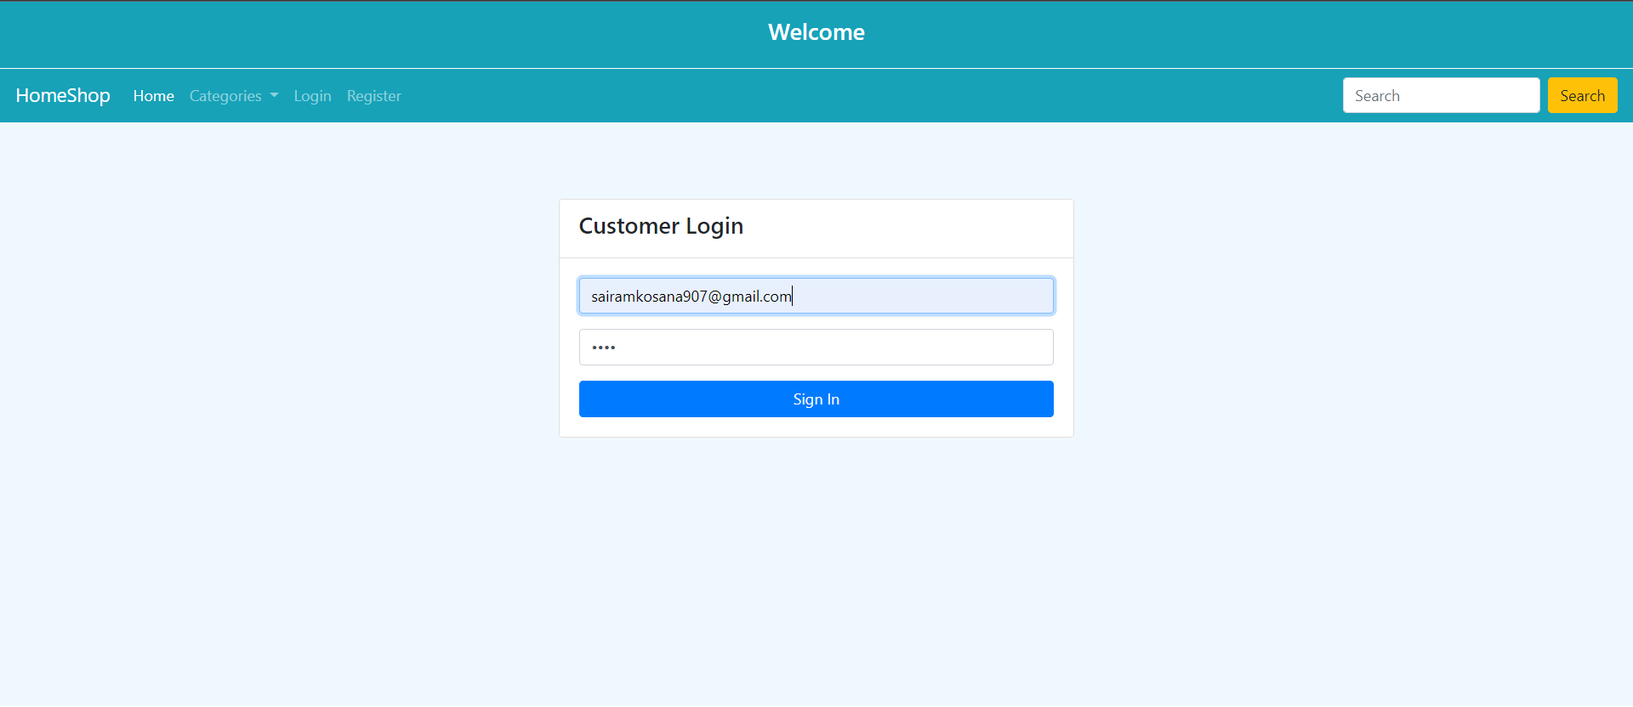
USER LOGIN-
saikrishnasanapala2021@gmail.com

Slide 18
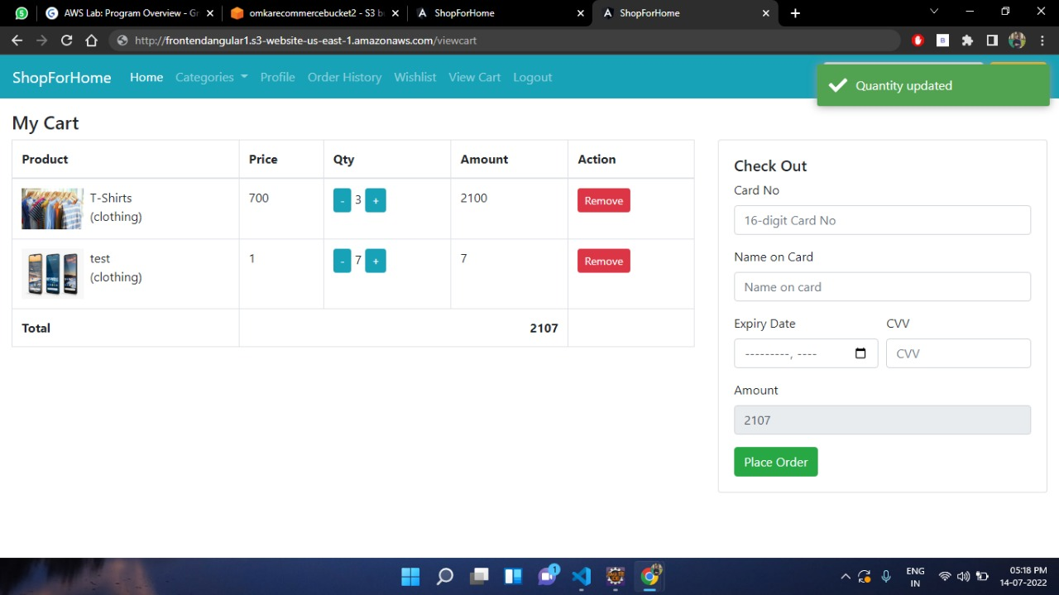
ADD TO CART-

Slide 19
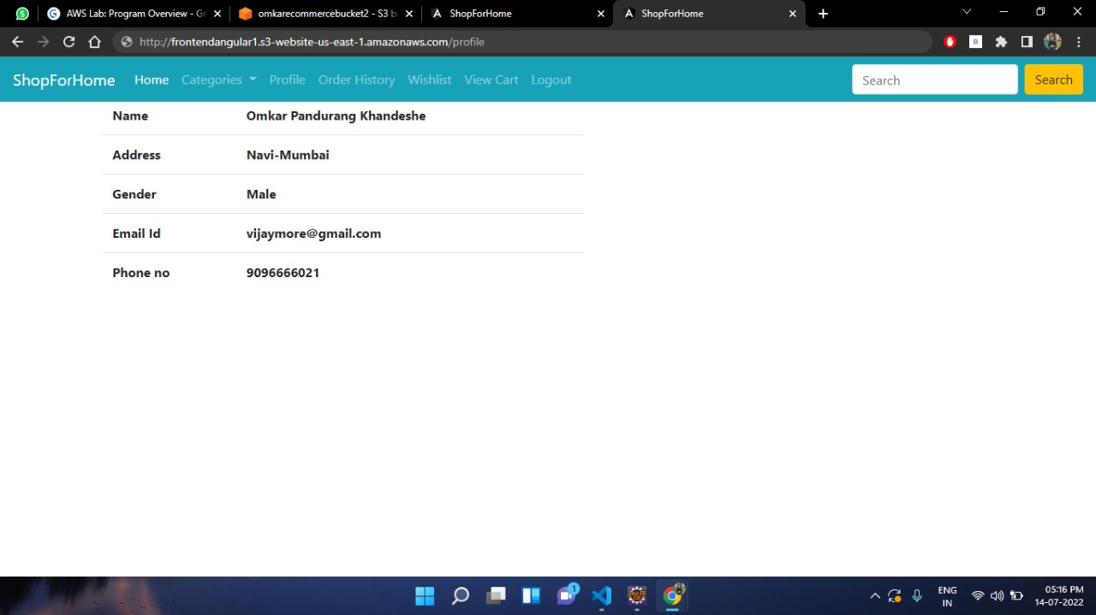
USER PROFILE-
Saikrishna sanapala
saikrishnasanapala2021@gmail.com

Slide 20
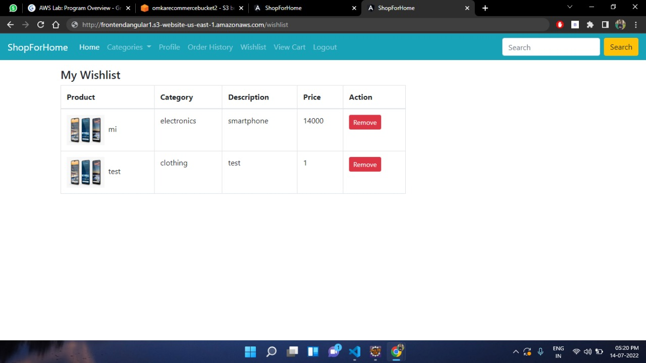
WISHLIST-

Slide 21
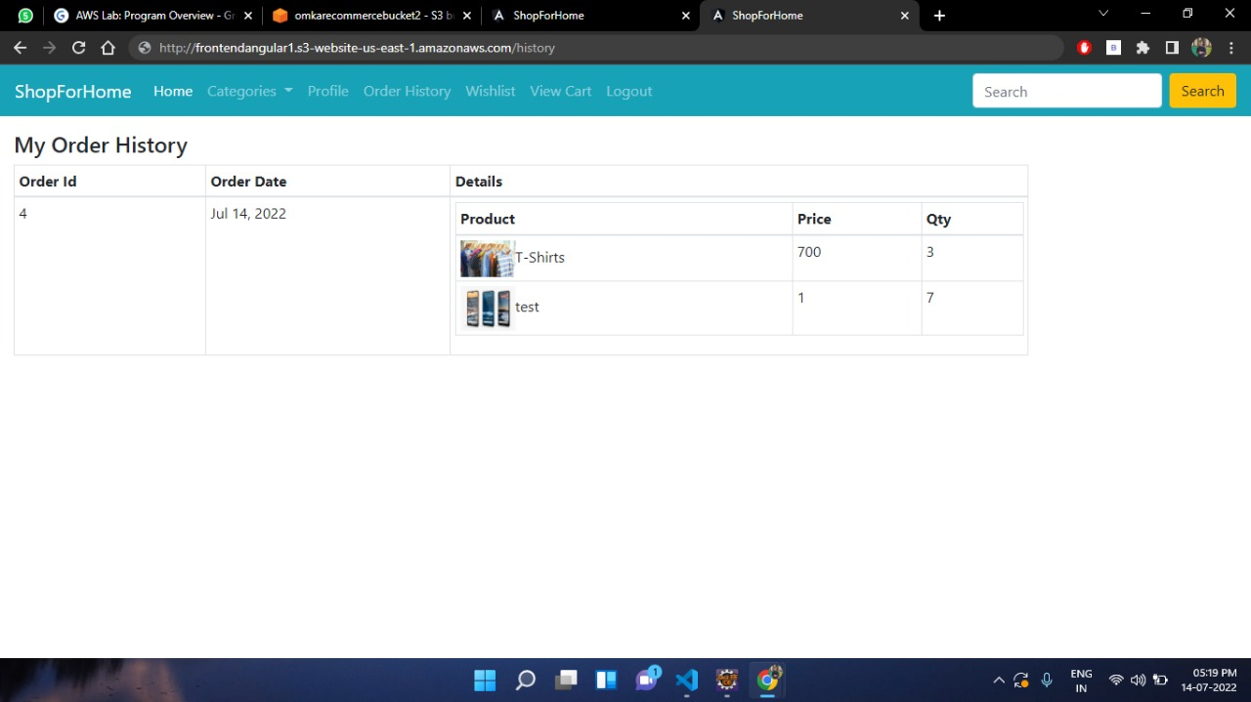
USER ORDER HISTORY-

Slide 22
Goal of Admin
Admin can be able to login, Logout and Register into the application.
Admin can be able to perform CRUD on Users.
Admin can be able to Perform CRUD on the products.
Admin can be able to get bulk upload option to upload a csv for products details
Admin can be able to get the stocks.
Admin can be able to mail if any stock is less than 10.
Admin can be able to get the sales report of a specific duration.
Admin can be able to set the discount coupons for the specific set of user.

Slide 23
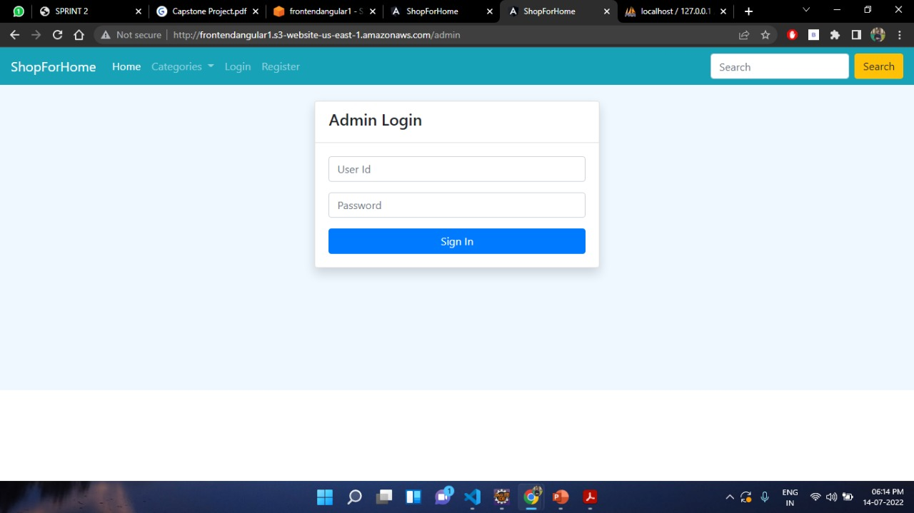
ADMIN LOGIN-

Slide 24
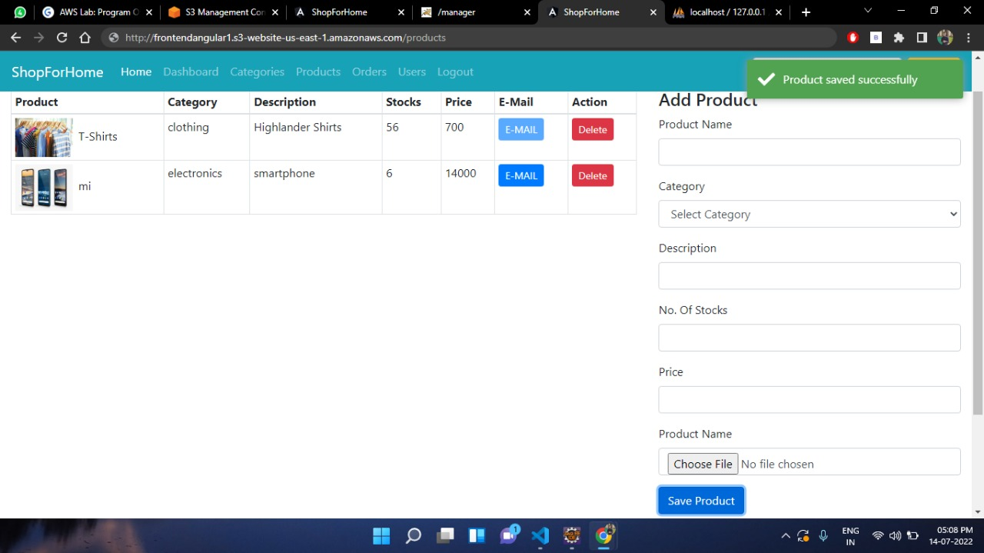
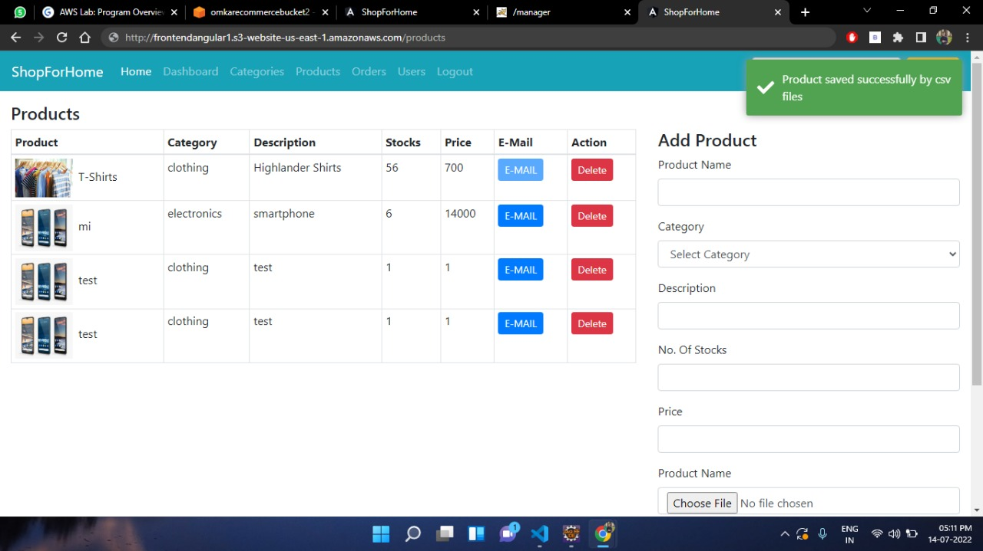
ADMIN(Adding product & Bulk Upload CSV)-

Slide 25
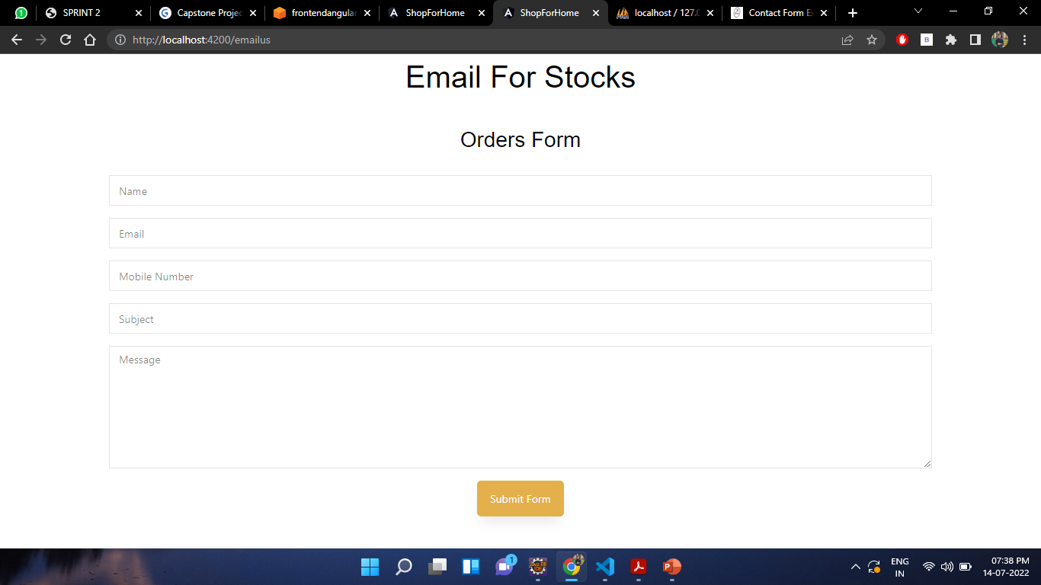
ADMIN( Email functionality when stock is less than 10)-

Slide 26
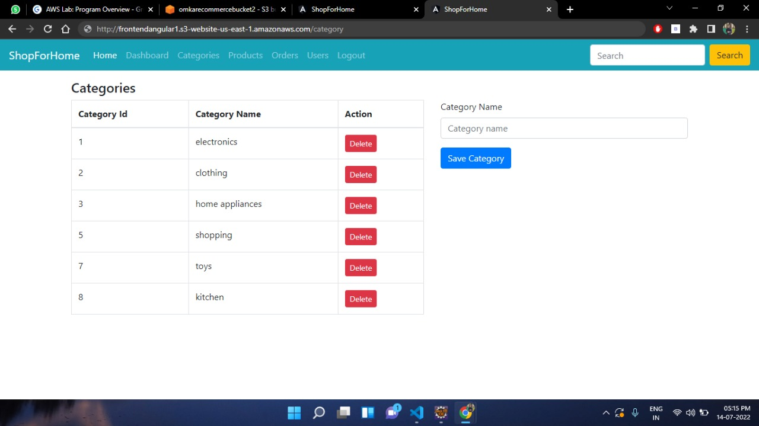
CATEGORIES(Admin side)-

Slide 27
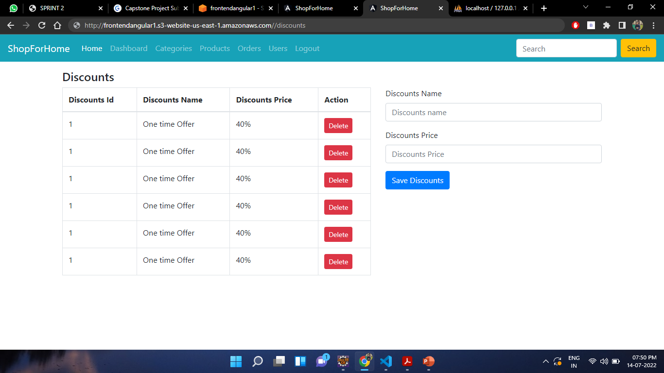
Discounts(Admin side)-

Slide 28
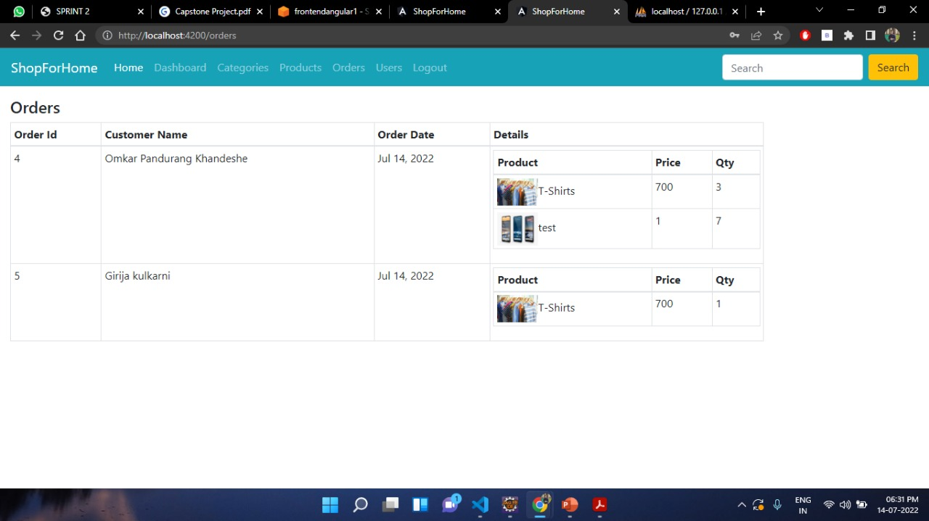
ADMIN ORDERS-

Slide 29
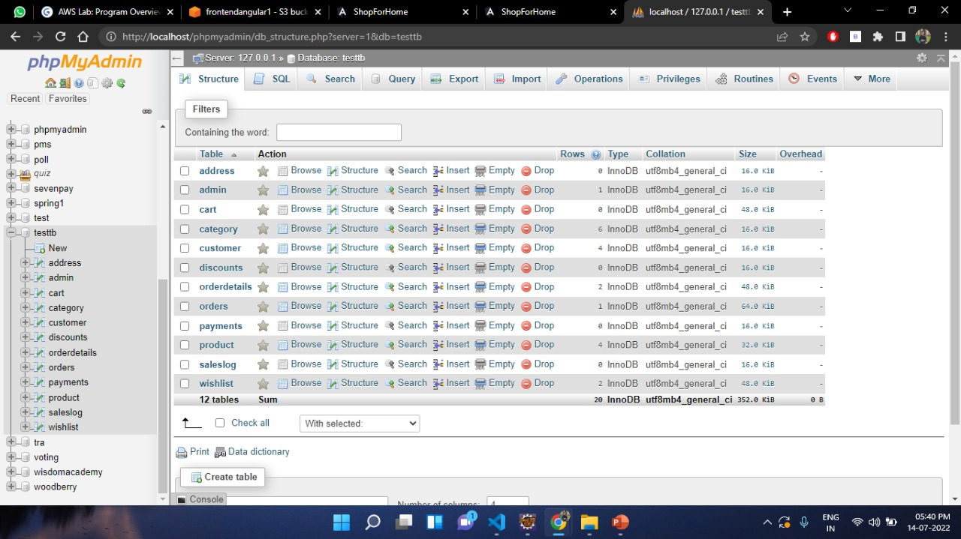
DATABASE(Tables)-

Slide 30
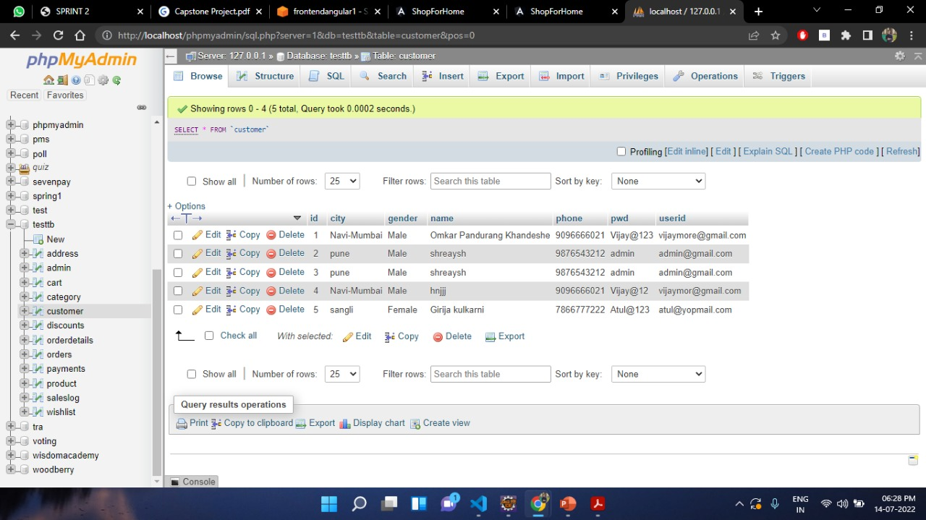
DATABASE(User Info.)-

Slide 31
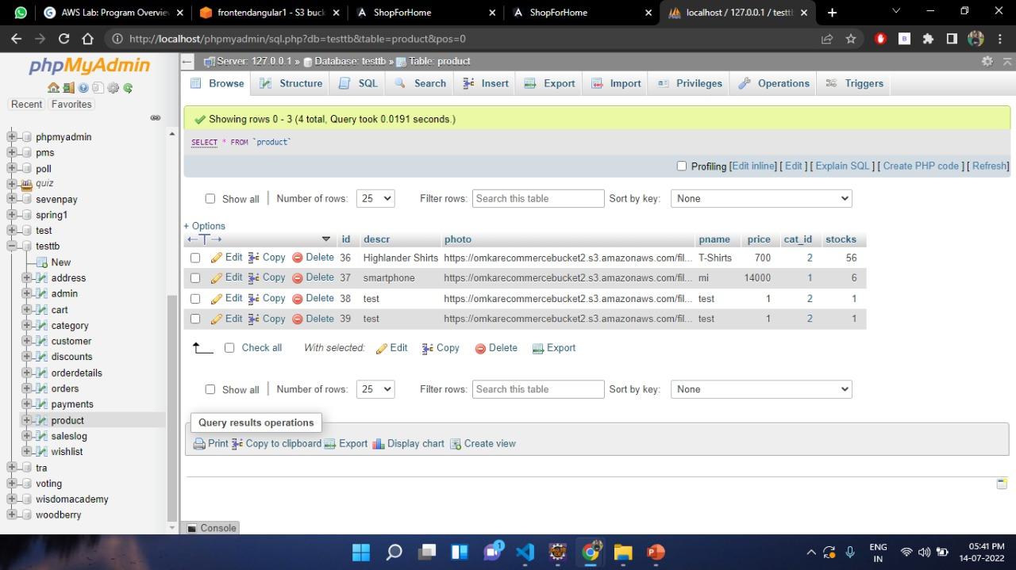
DATABASE(Product Info.)-

Slide 32
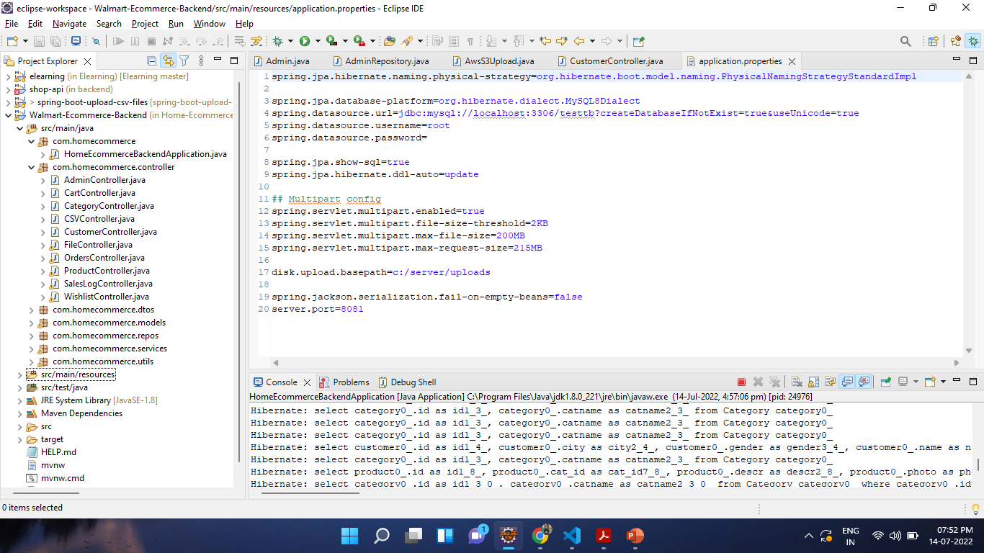
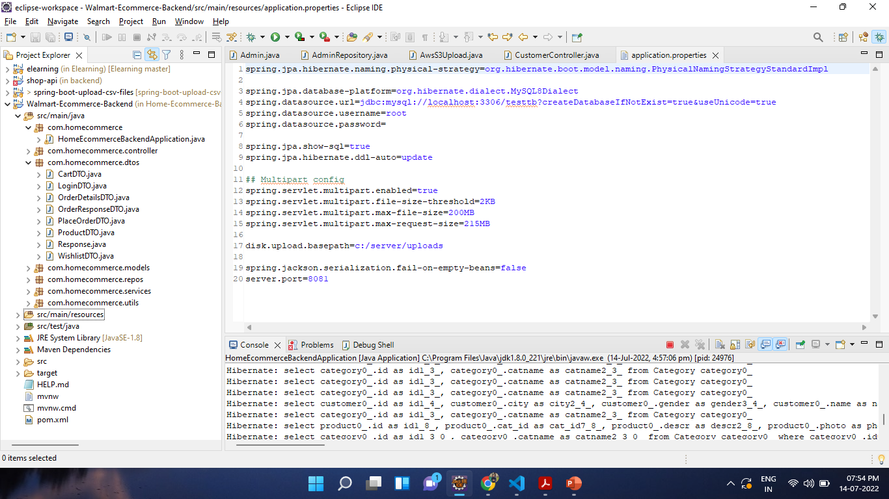
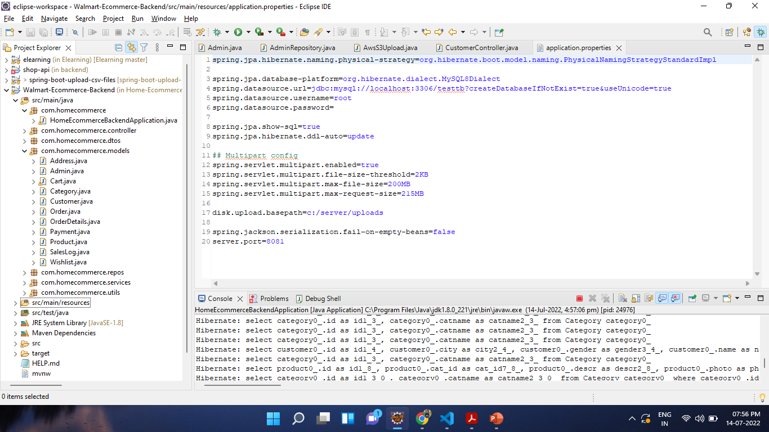
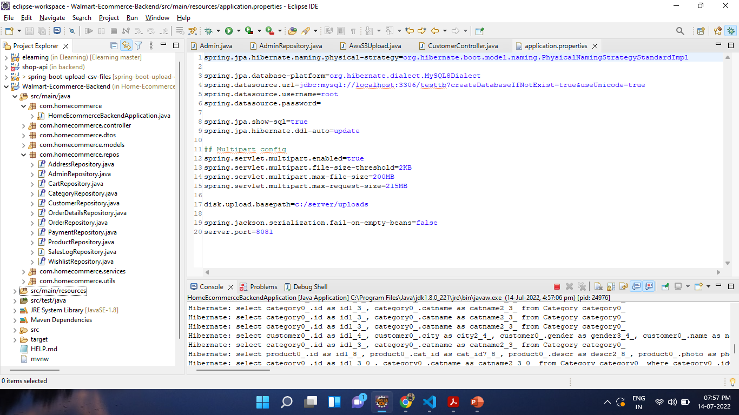
Spring Boot(Controllers, Repository, Data Transfer Object, Entity)-

Slide 33
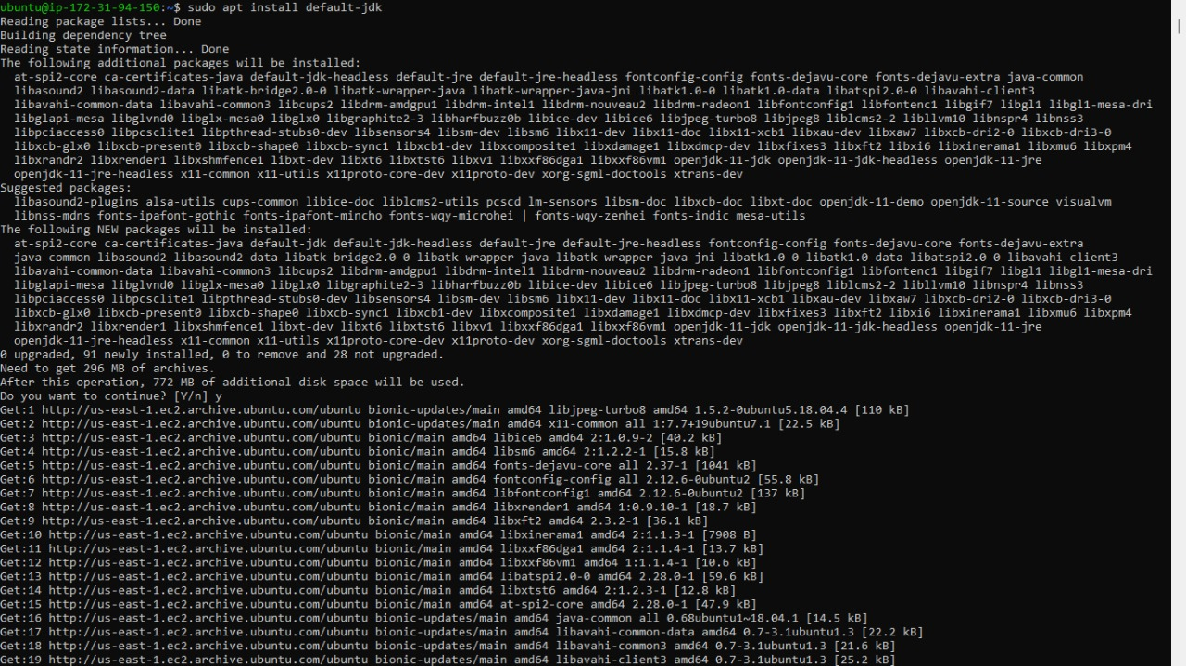
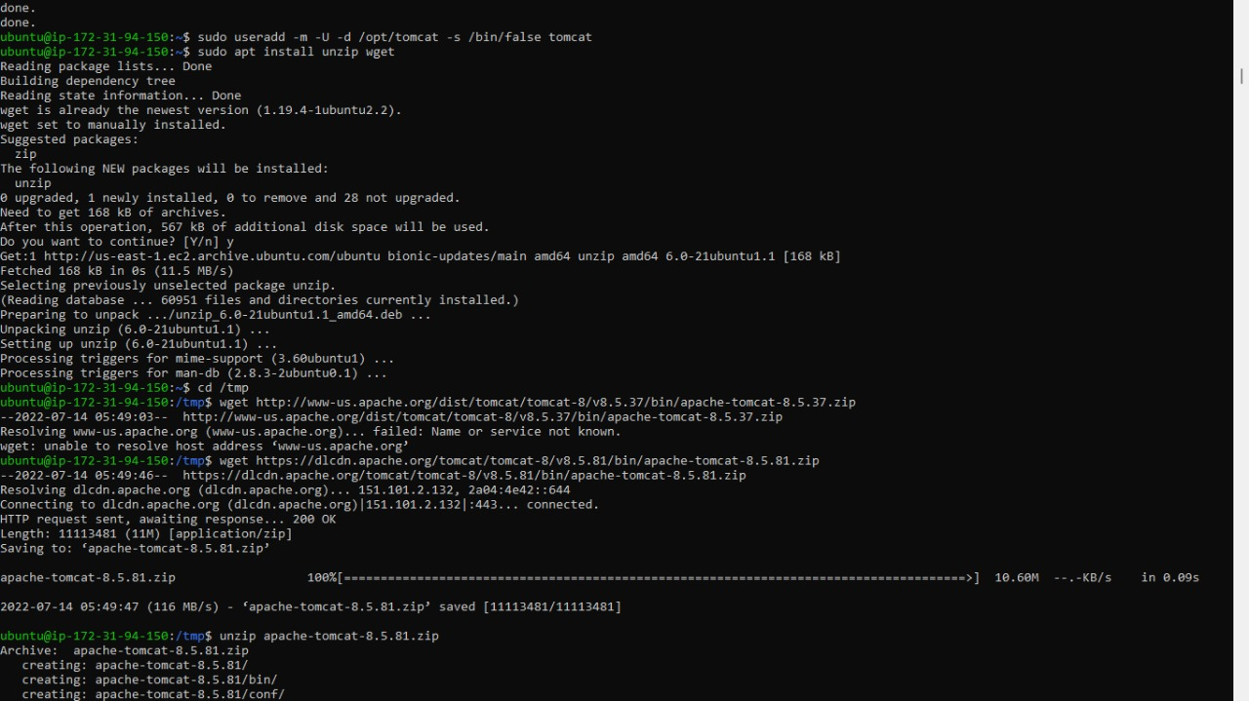
Installation of tomcat web server manager & Mysql
On EC2 Instances(AWS)-

Slide 34
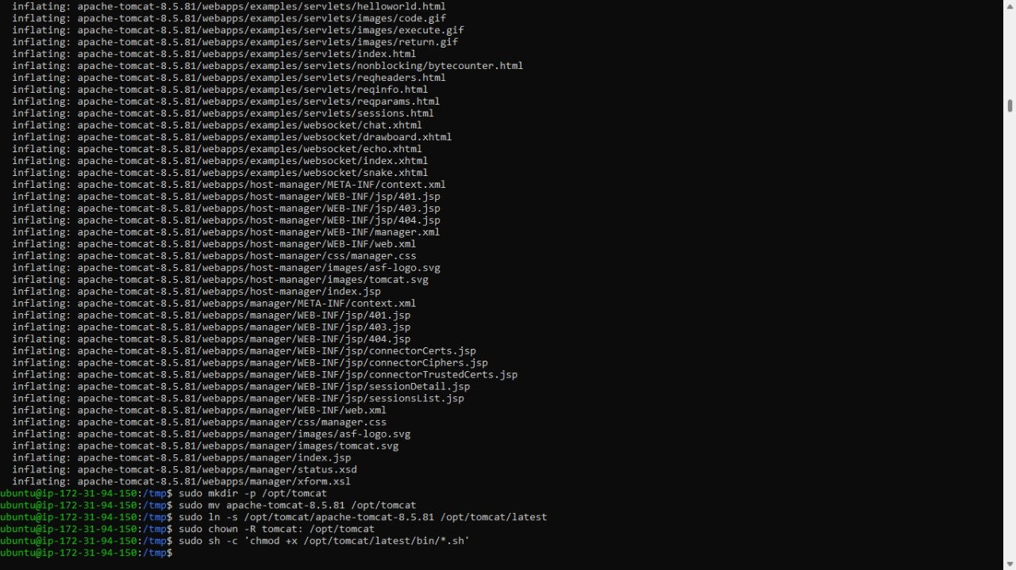
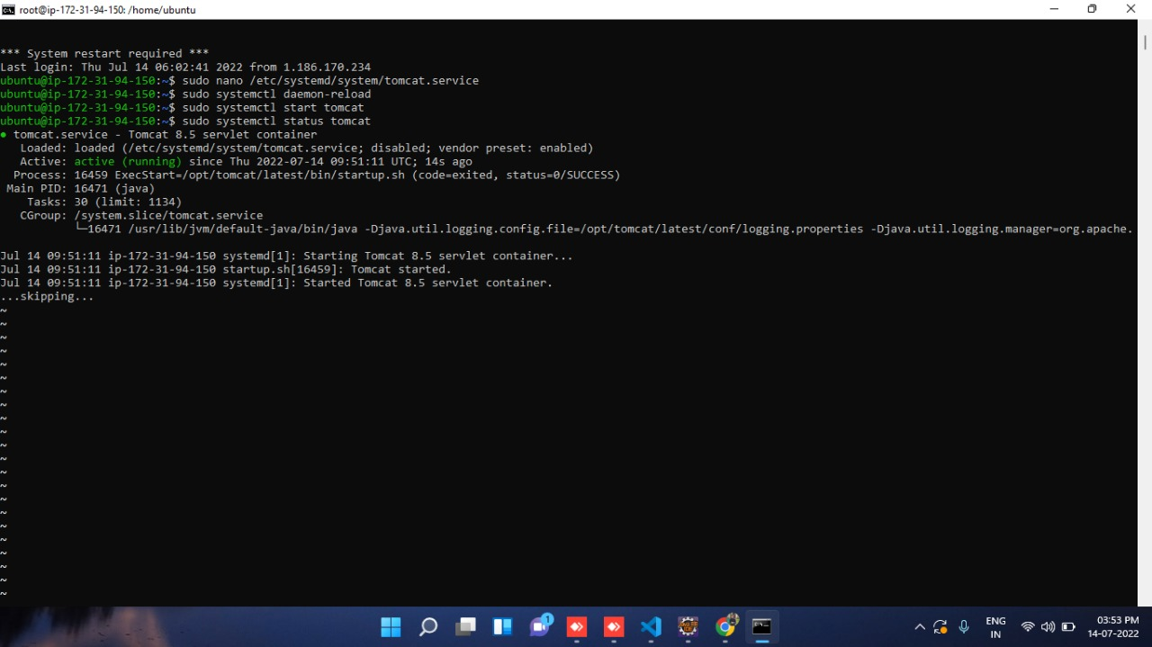

Slide 35
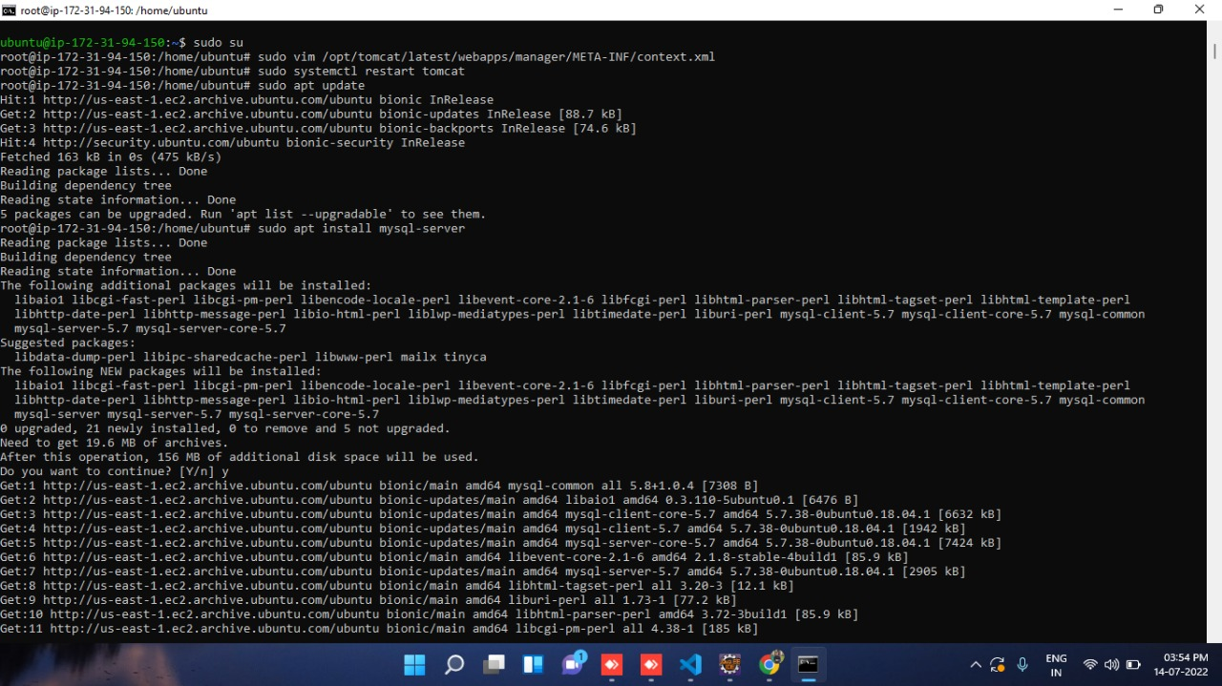
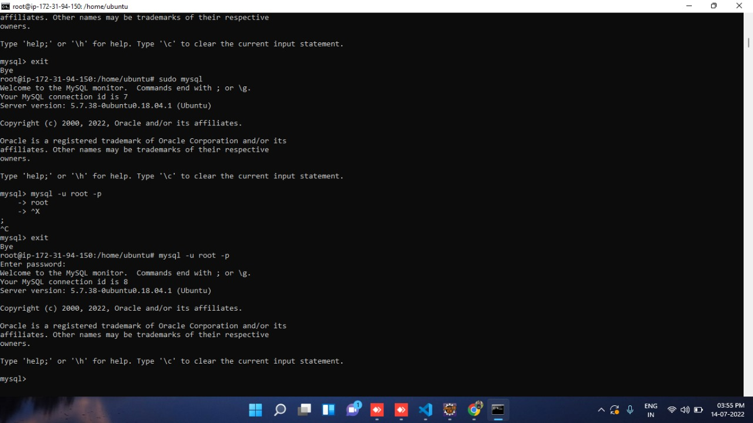

Slide 36
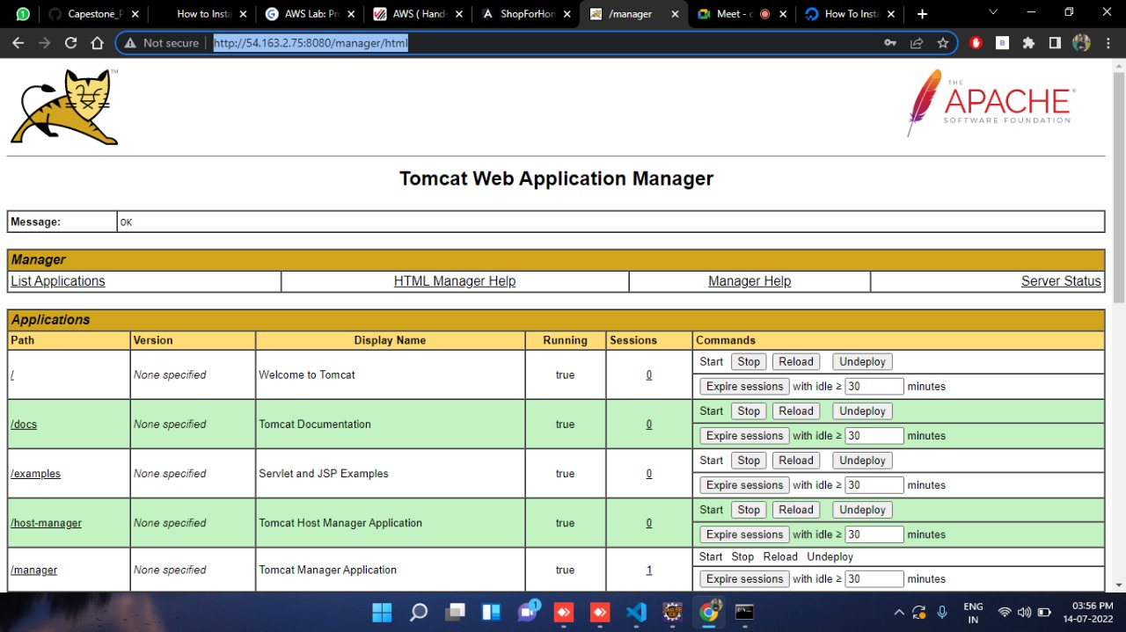
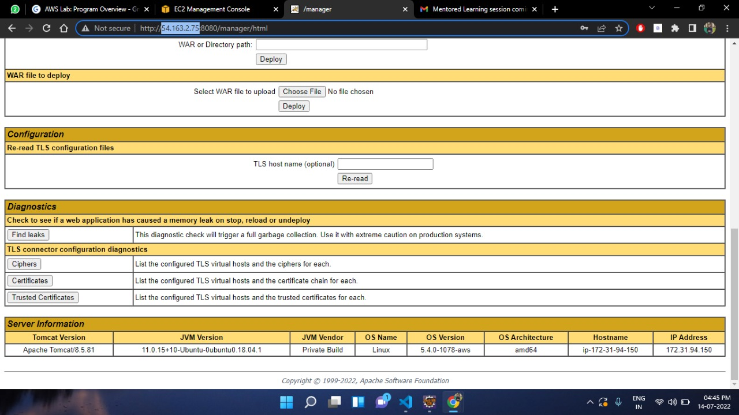
Installation of tomcat web server manager & Mysql
On EC2 Instances(AWS)-

Slide 37
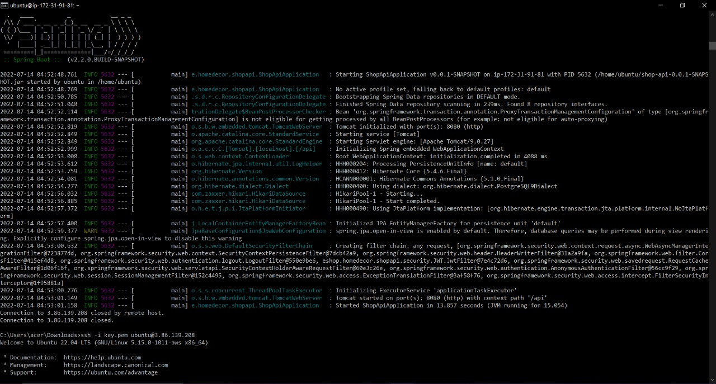
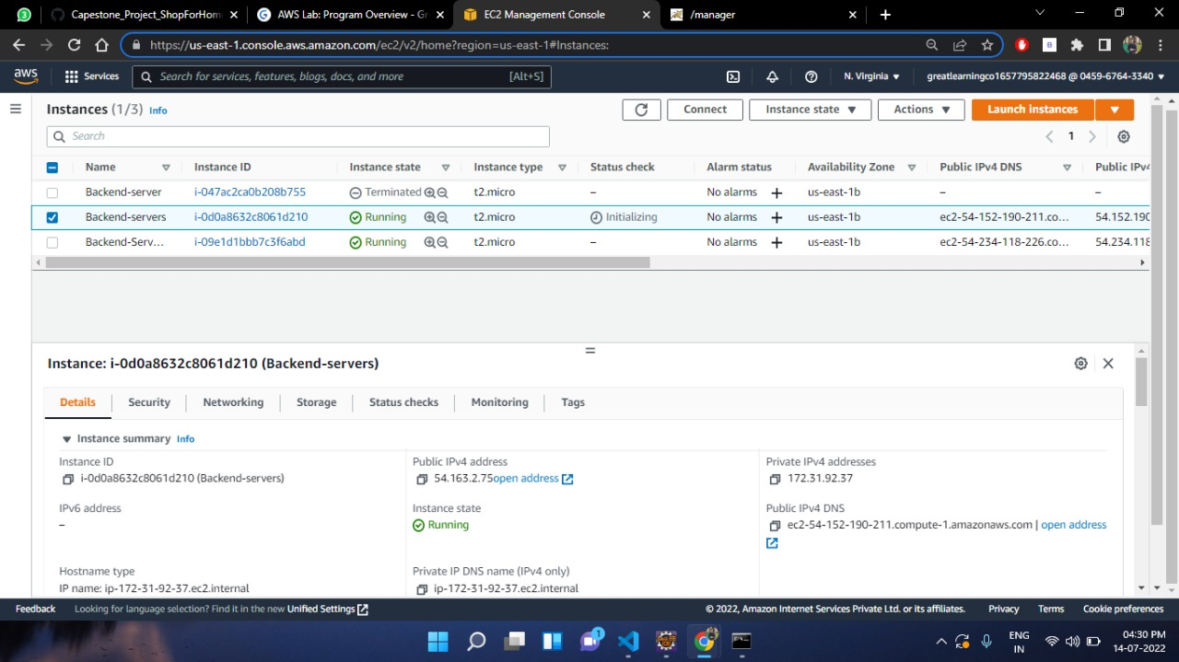

Slide 38
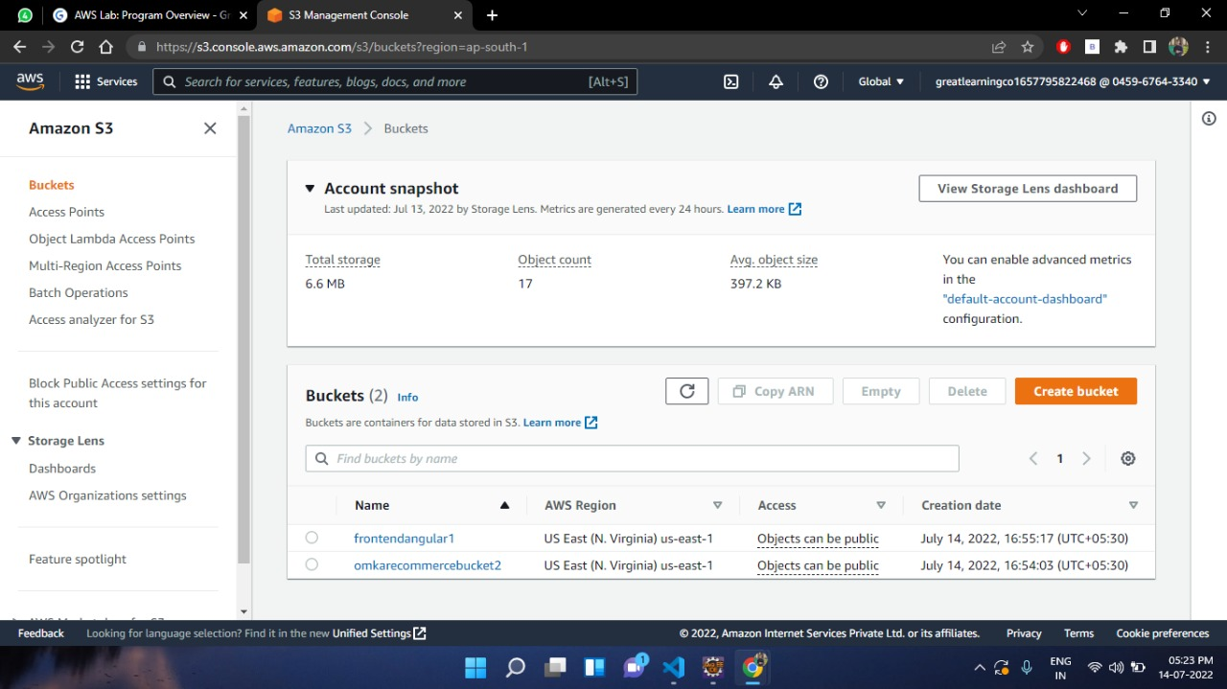
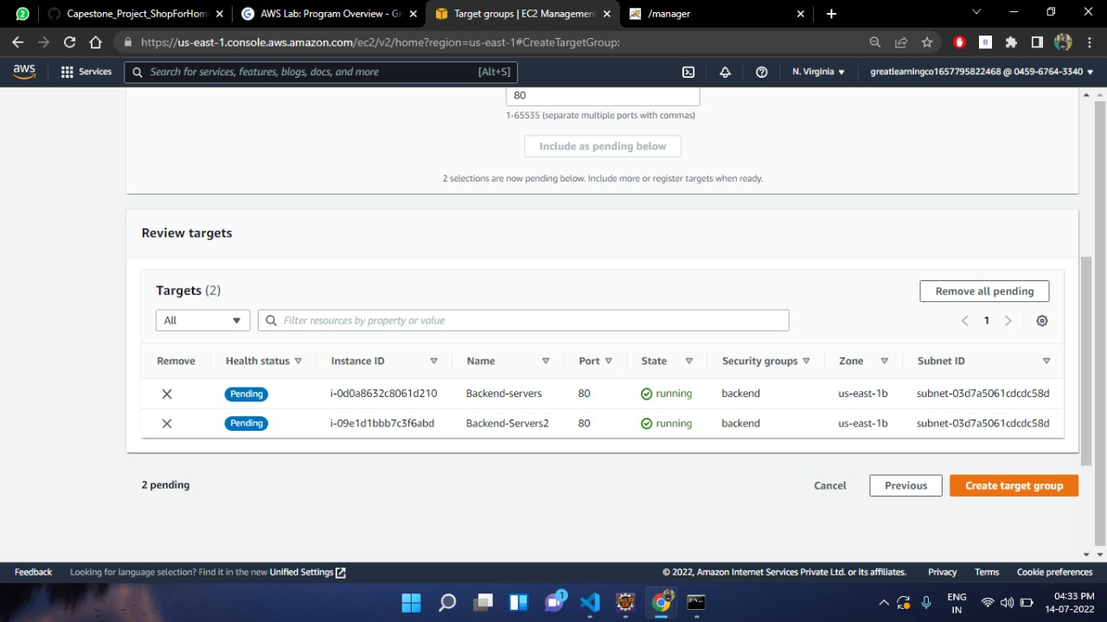
S3 Buckets, Load Balancer & Auto Scaling Groups

Slide 39
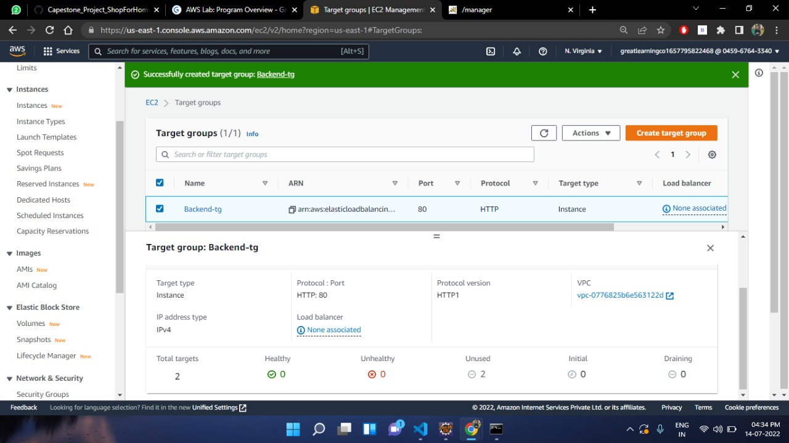
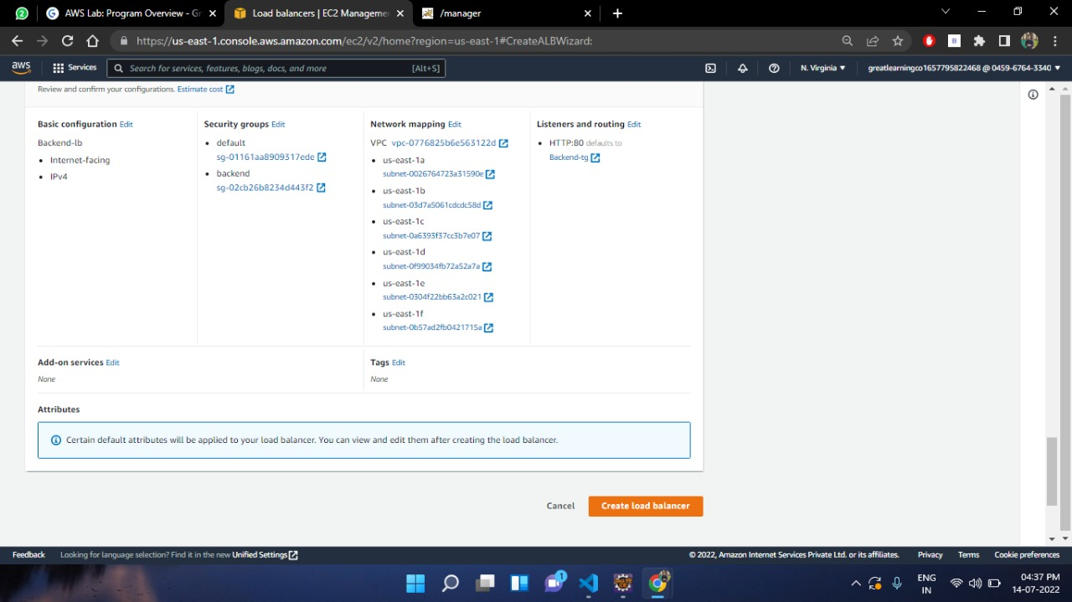

Slide 40
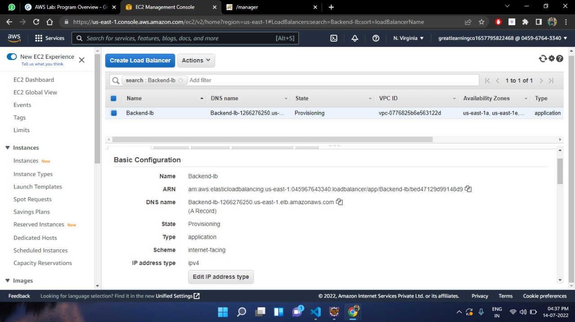
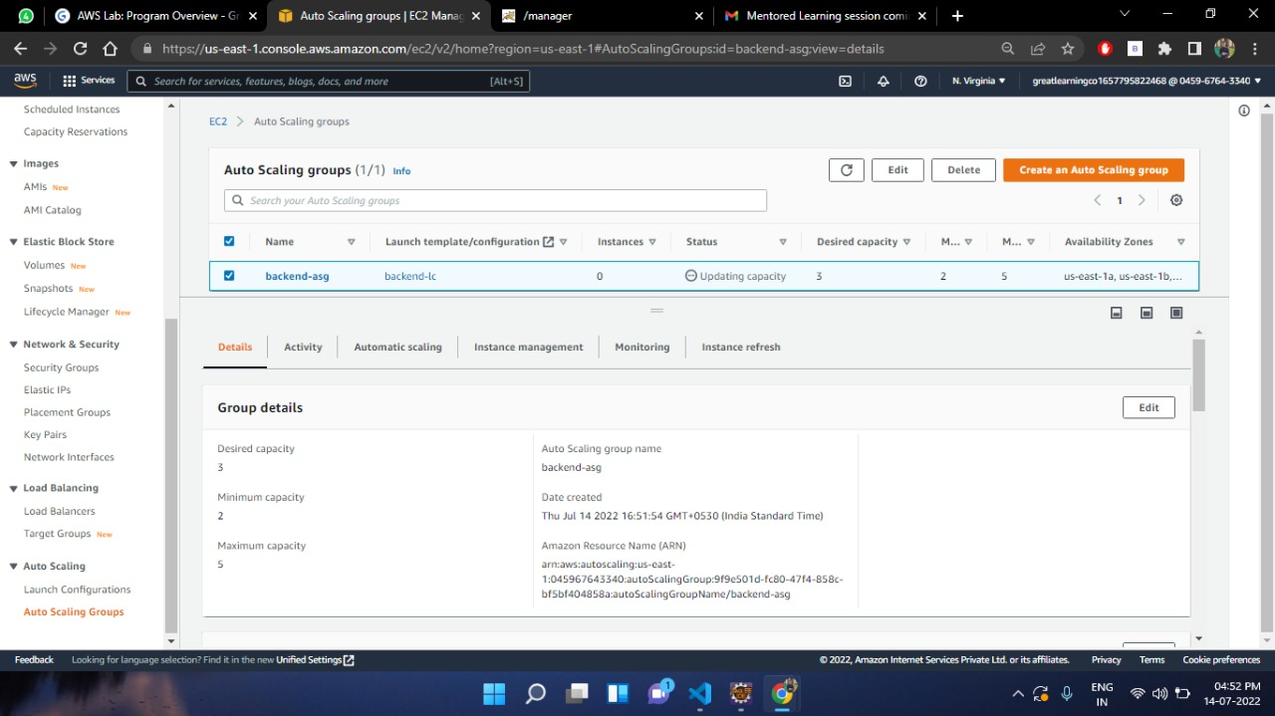

Slide 41
Conclusion
Technology has made significant progress over the years to provide consumers a better online shopping experience and will continue to do so for years to come.
With the rapid growth of products and brands, people have speculated that online shopping will overtake in-store shopping.
However, the availability of online shopping has produced a more educated consumer that can shop around with relative ease without having to spend a large amount of time.

Slide 42


